Slide 1
EcoDIY www.ecodiy.org
Sub-urban self reliance in Clacton Essex
Shelter - Energy - Food - Community

Slide 2
Food
Energy
Things
Community

Slide 3
Food
Eat less meat
Eat more vegetables!!
Grow your own (easier than you think)
Buy from local producers
Trade with other growers
Waste less
See waste as a resource

Slide 4
BBC Working Lunch

Slide 5
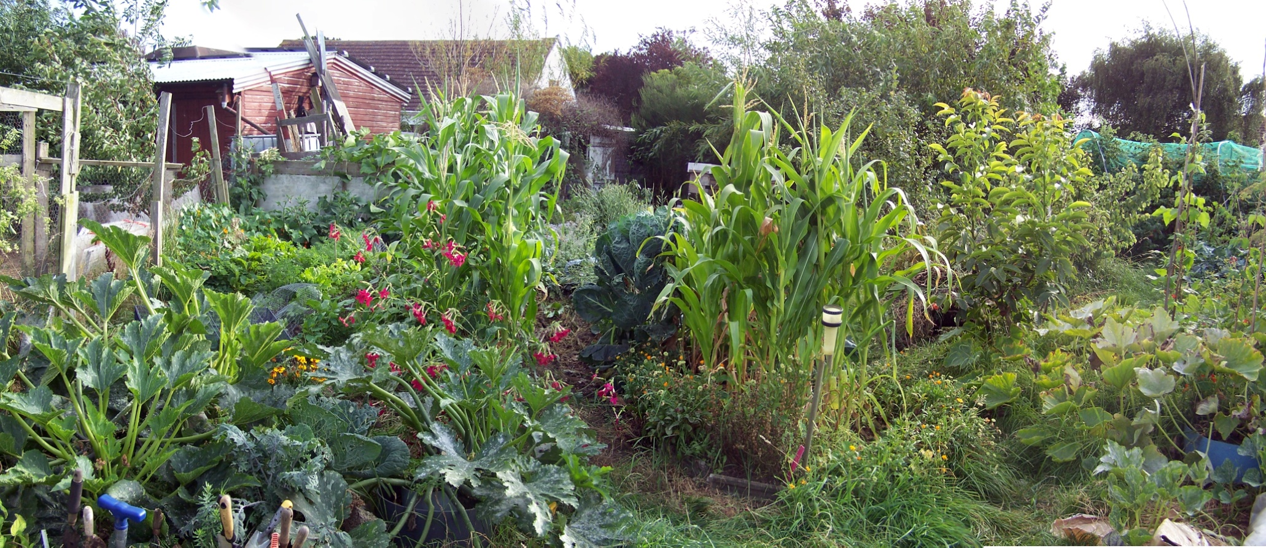
Food- vegetables
Notes:
In full summer flow

Slide 6
Possible Outside inputs
Grass cuttings
Animal manure
Food waste
Gleaned vegetables – potatoes, onions etc
Traded fruit/vegetables ie apples, plants
Seeds
Wheat, straw
Lime, seaweed etc
Traded Volunteer labour

Slide 7
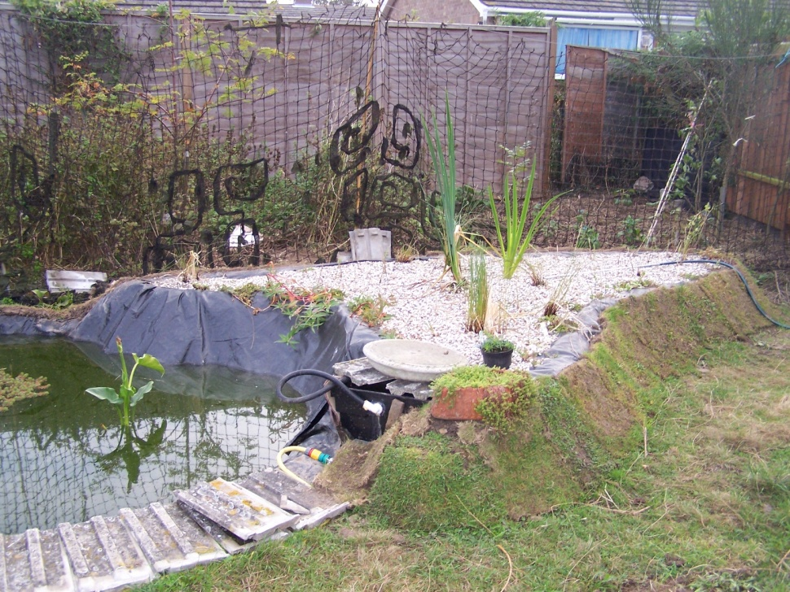
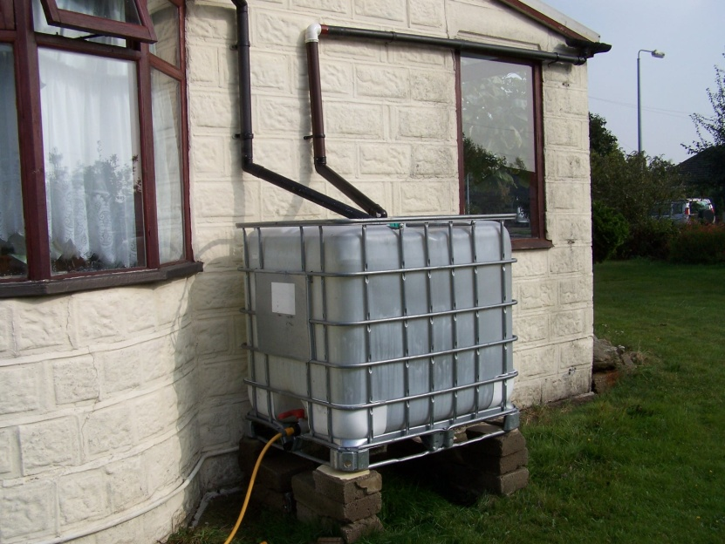
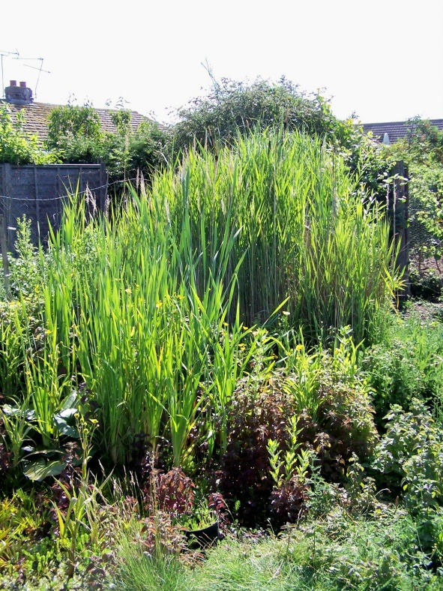
Water harvesting
Reed bed and pond
Rainwater harvesting
Notes:
Reed bed recycling grey water from the house. 4000 litres of rainwater collection in total

Slide 8
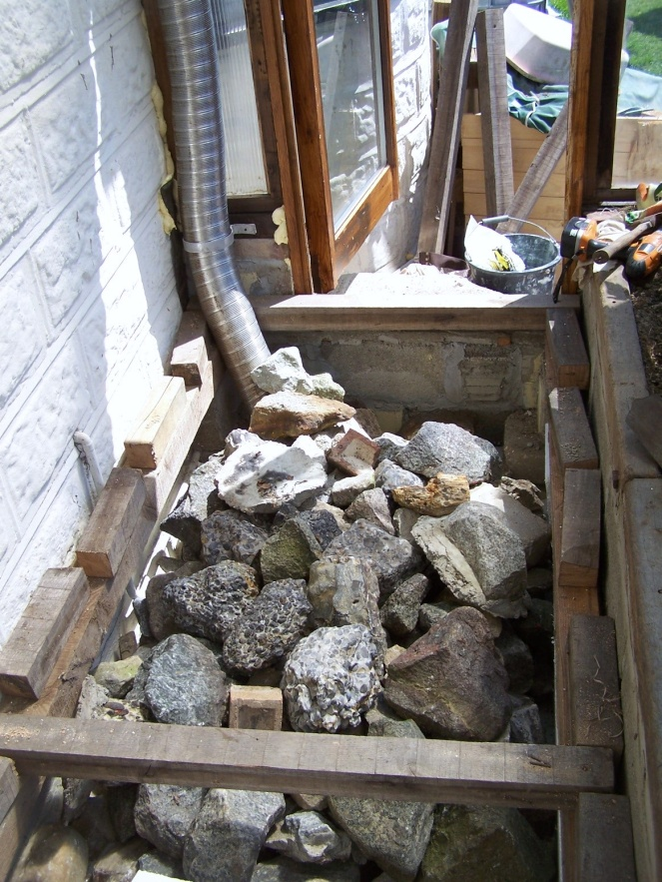
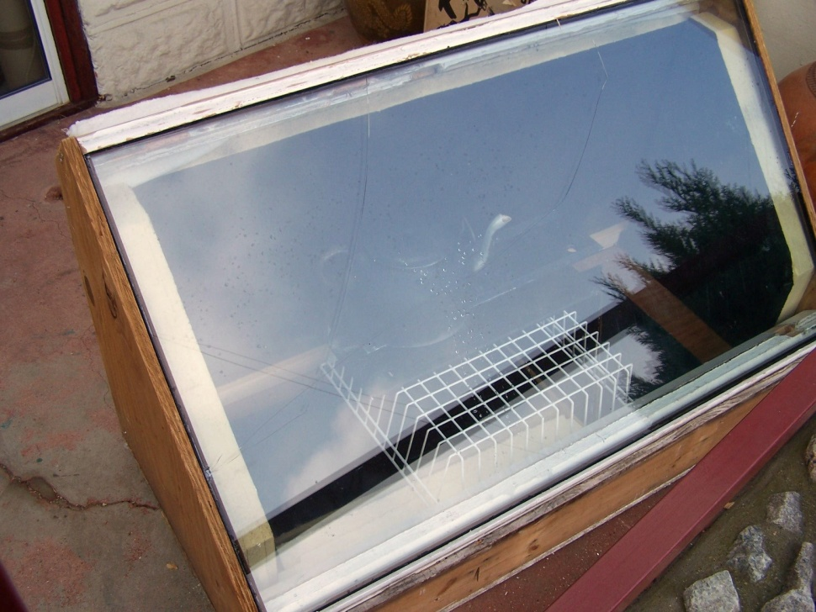
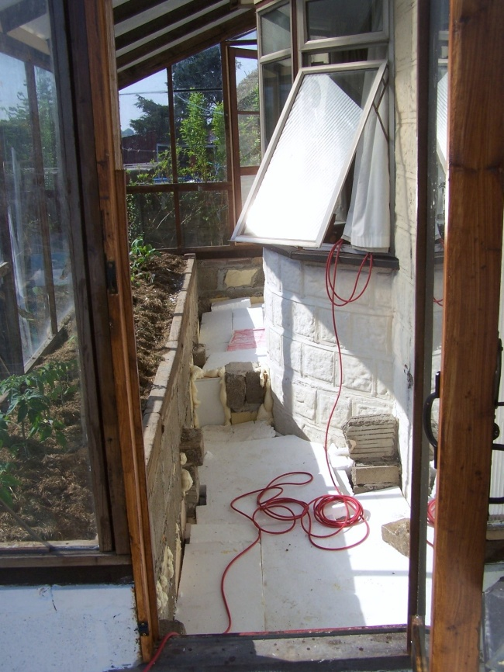
Solar energy harvesting
Notes:
Our lean-to greenhouse has a trench beneath the floor filled with rocks to store the midday heat
And solar drier

Slide 10
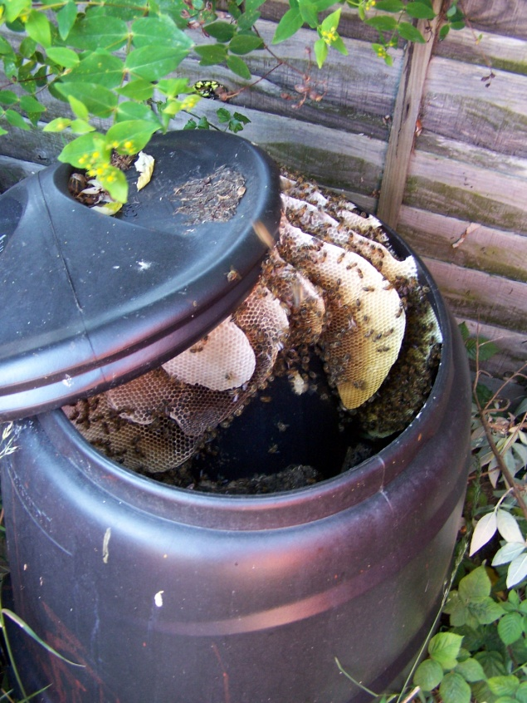
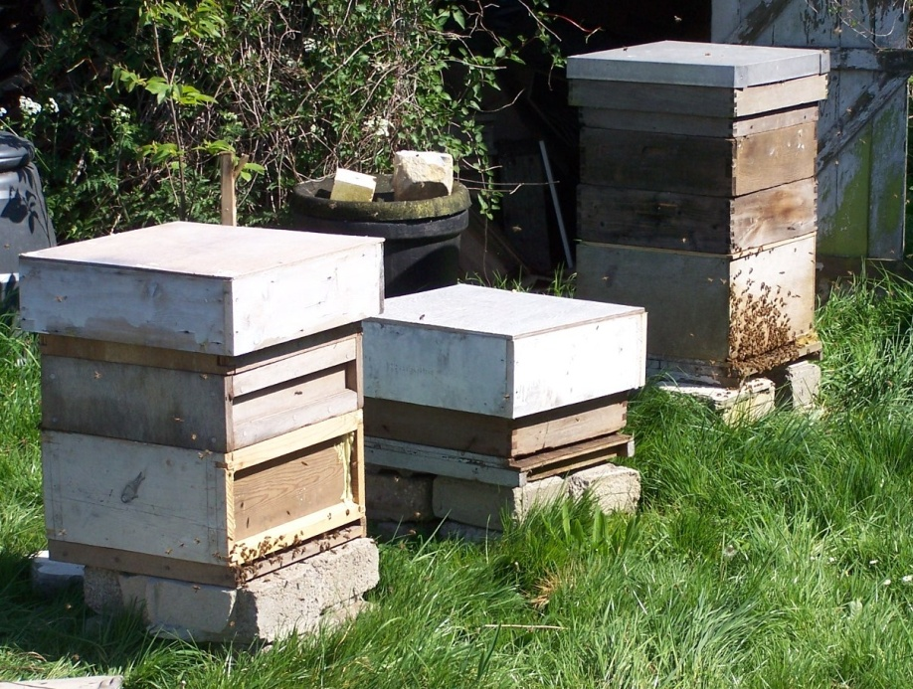
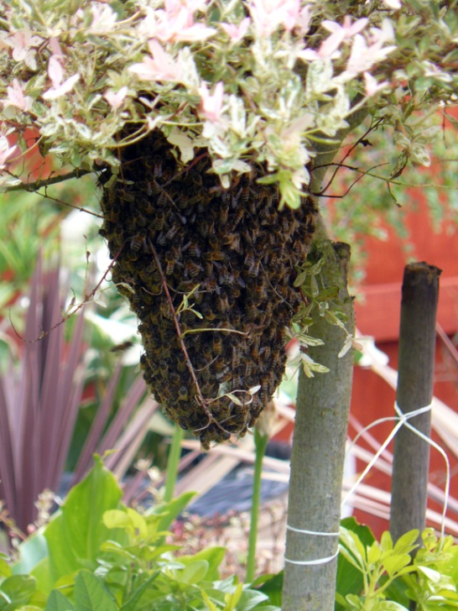
Food – livestock -bees
Notes:
Bees – truly wild urban farm stock!

Slide 11
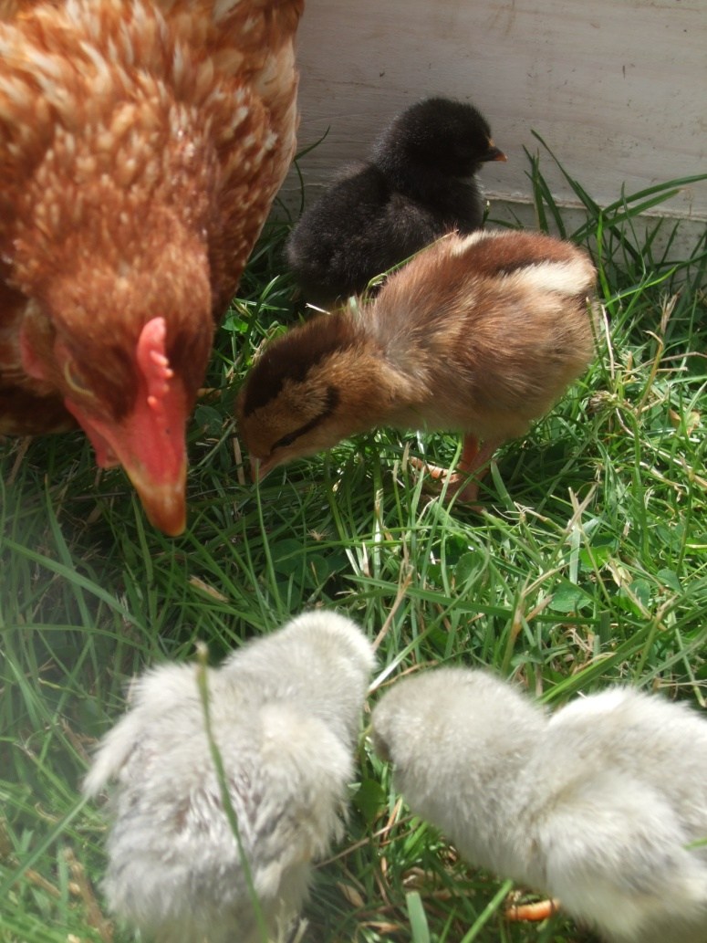
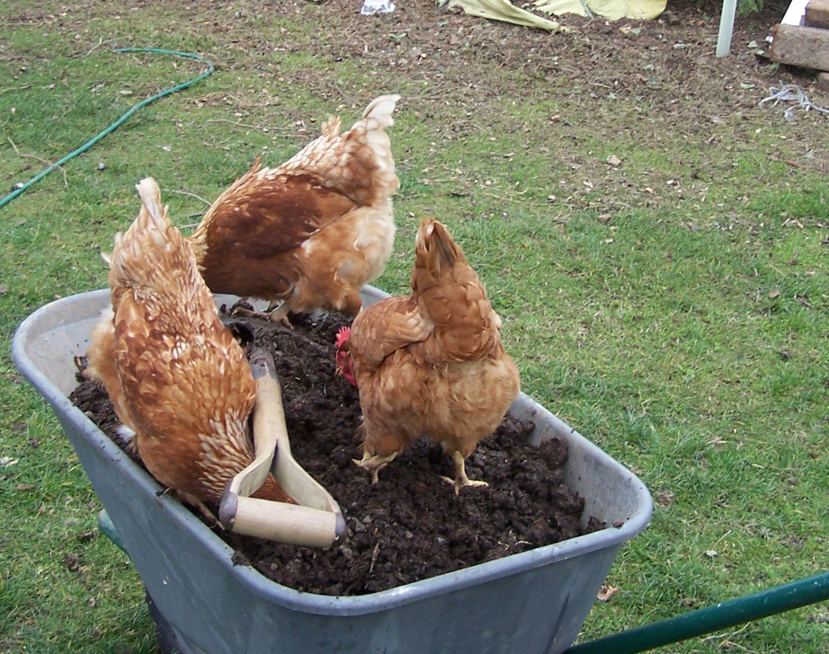
Food - livestock -hens
Notes:
Great recyclers chickens!

Slide 12
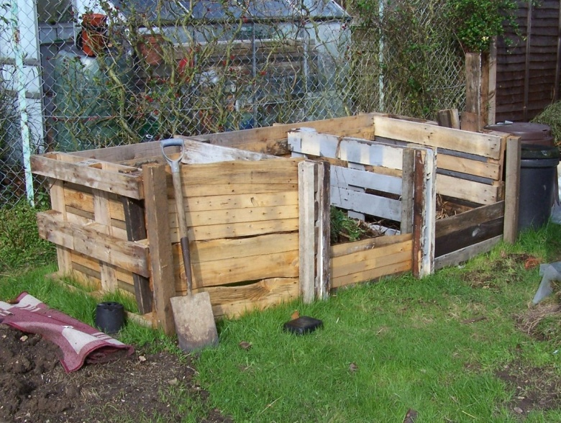
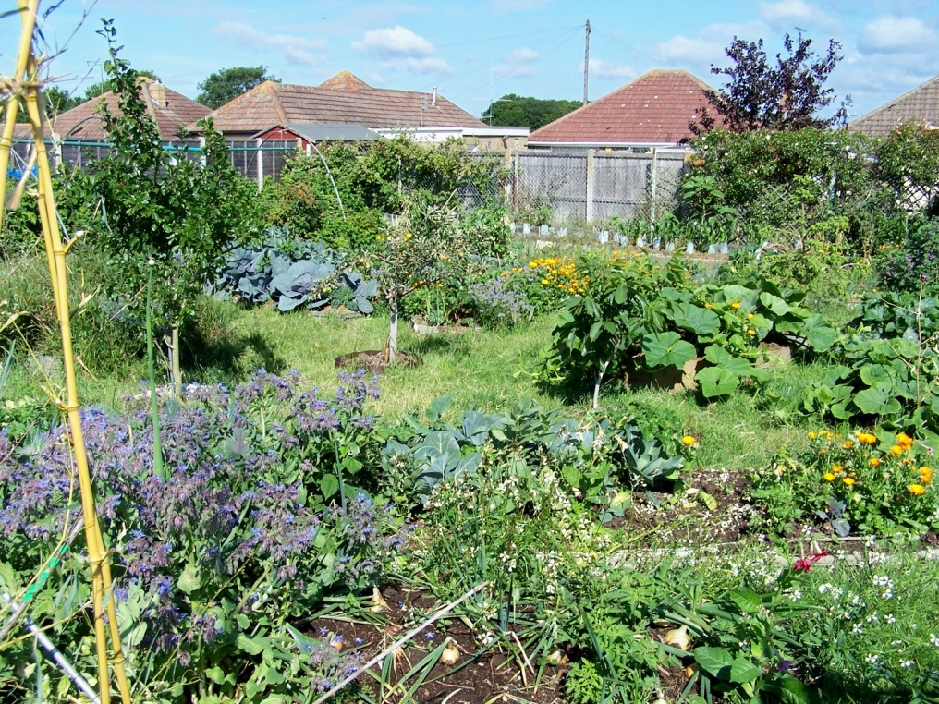
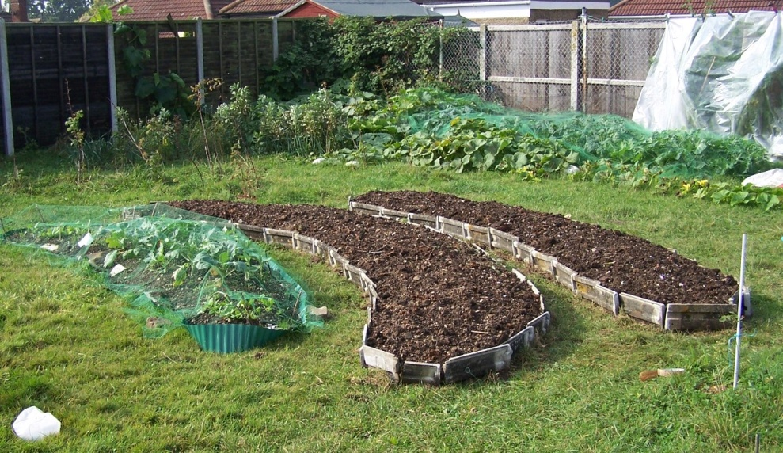
Food- vegetables
Notes:
Compost bin from pallets – people donate us their compost and grass cuttings. Deep beds before and after

Slide 13
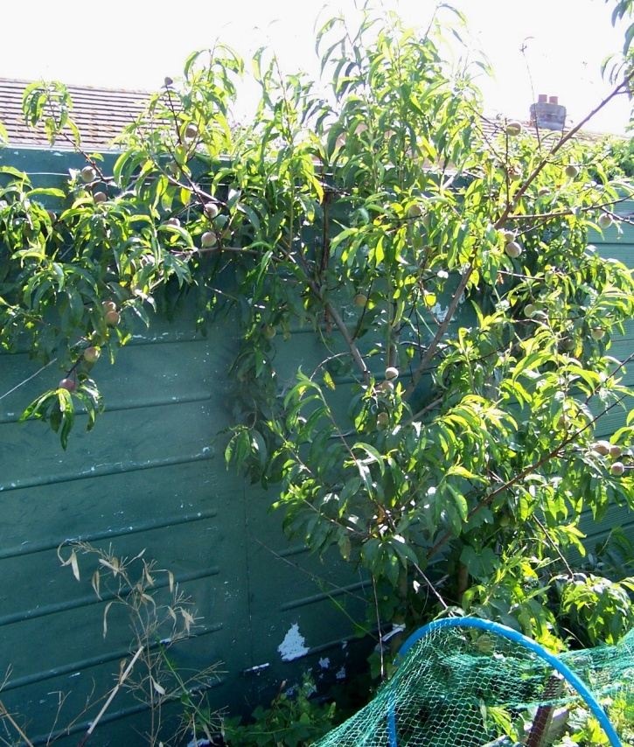
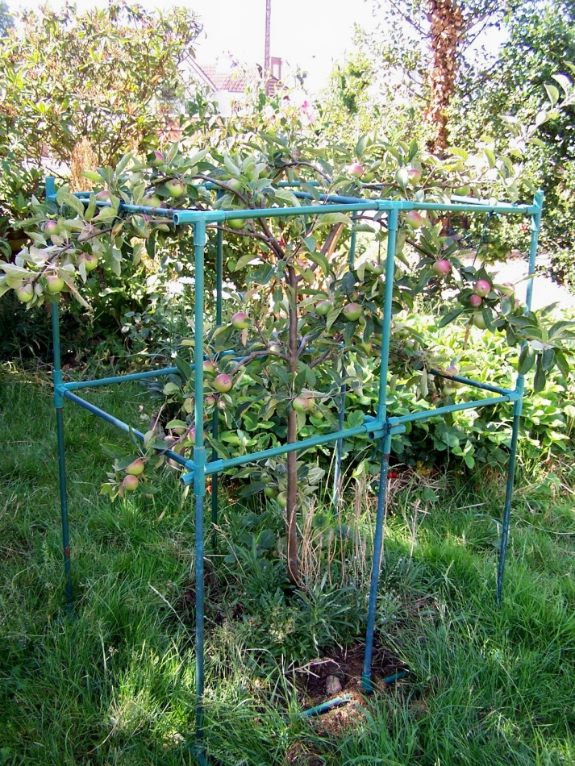
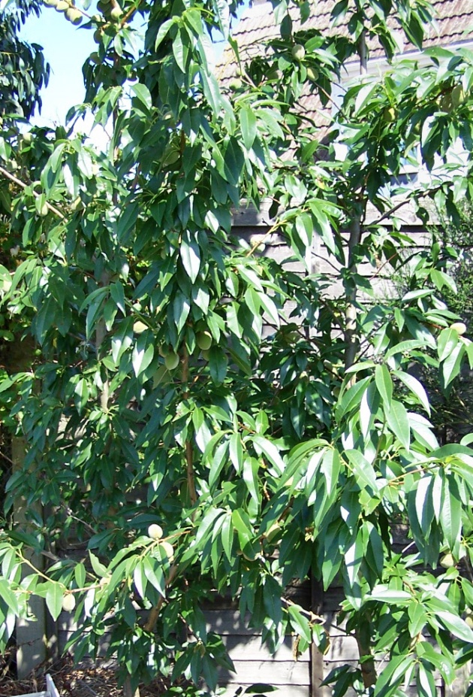
Food – fruit and nuts
Walnuts
Hazels
Almonds
Peaches
Pears
Apricots
Grapes
Figs
Apples supported in a recycled cage
Notes:
Peaches, almonds, apples

Slide 14
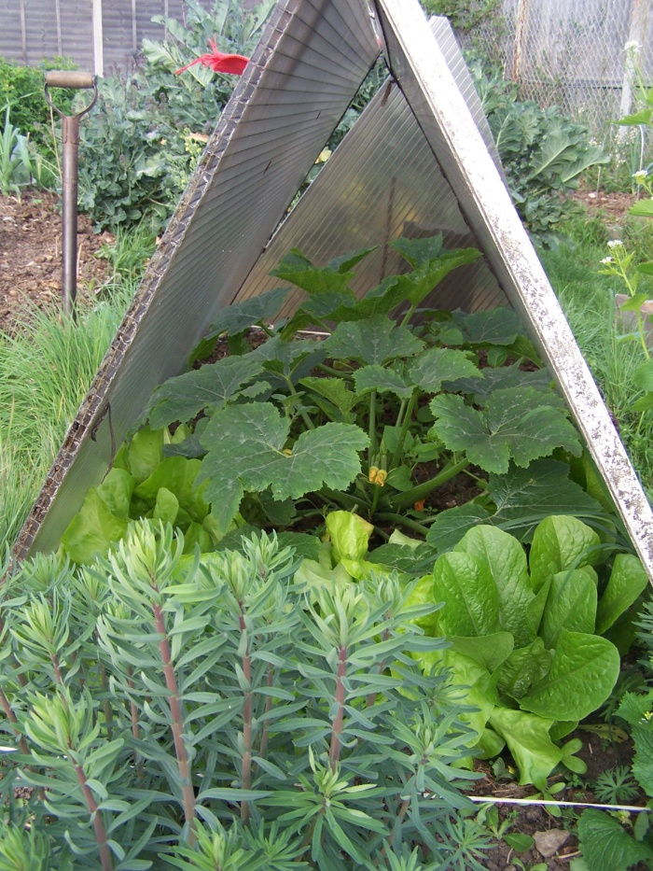
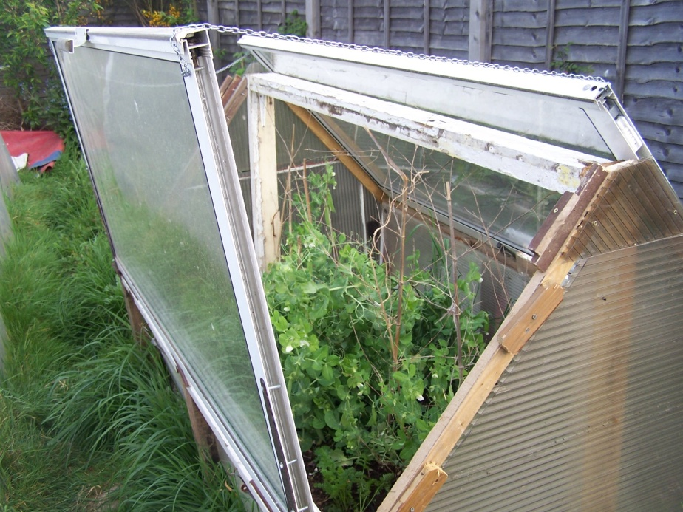
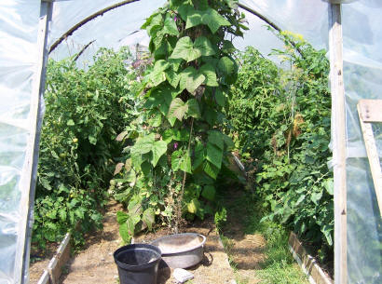
Food - protection
Shower door cold -frame
Polycarbonate cloche
Poly tunnel
Notes:
Protection is essential to extend the season – using re-cycled polycarbonate, double glazing and polythene.

Slide 15
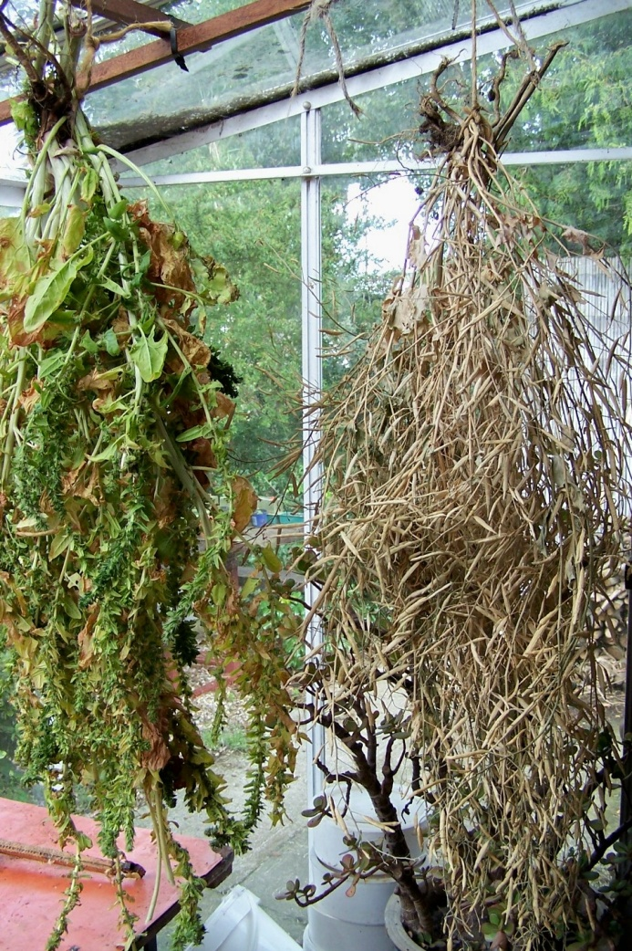
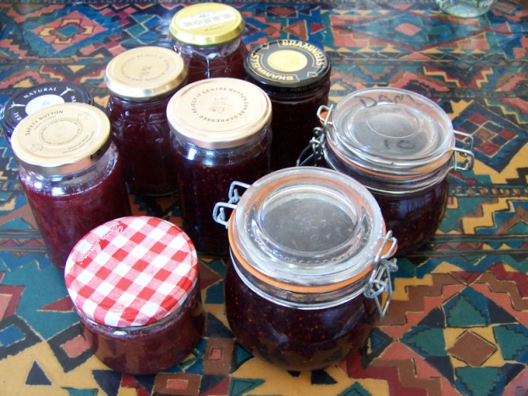
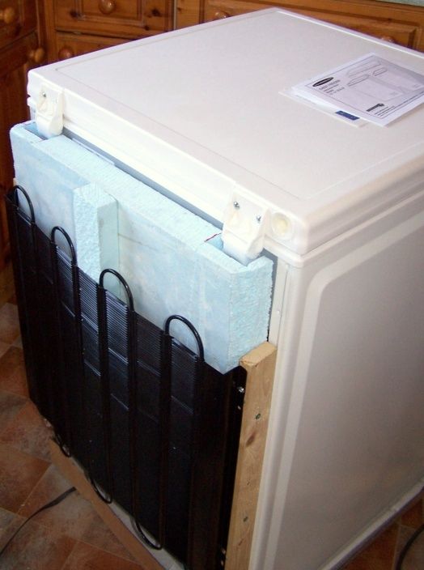
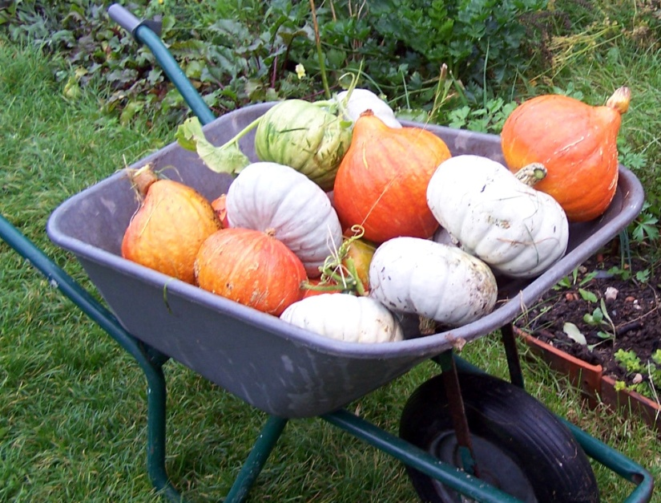
Food – saving seed and storing crops
Insulating our freezers
Saving our own seed
Notes:
Storing food as seed, squashes and roots and bottled and frozen (adding insulation to the freezer.)

Slide 16
Check out our new website
www.ecodiy.org
Do come and look round ring 01255 254548 or email chris@ecodiy.org to make an appointment

